Slide 1

Introductory Statistics
Introductory Statistics

Slide 2
Inference for Bivariate Data
Intro to Inference in Regression
Requirements for Linear Regression
Linear Relationship
Constant Variances
Error term is normal
Hypothesis Testing
Confidence Interval

Slide 3
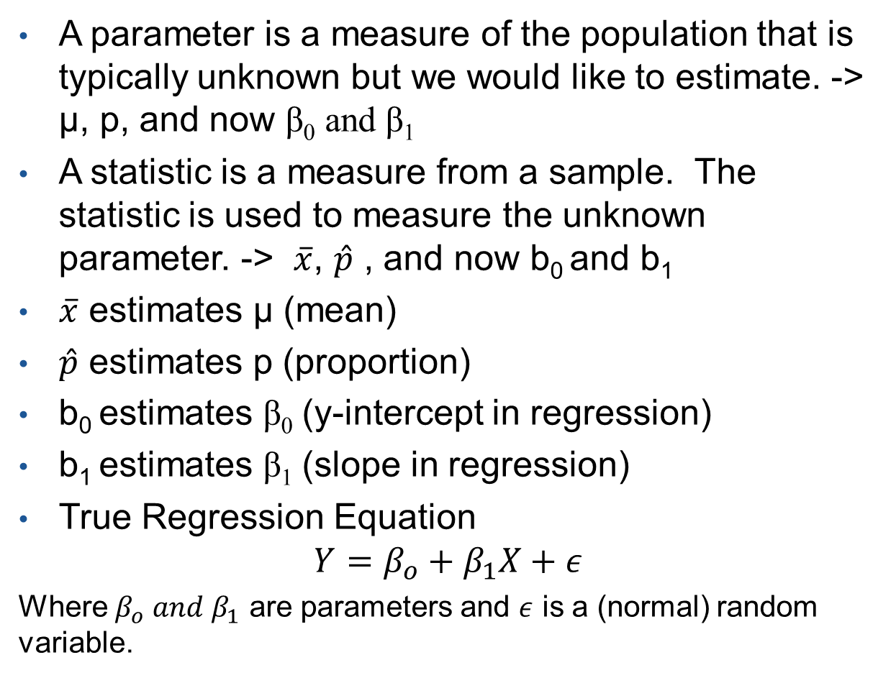
Parameter and Statistic
A parameter is a measure of the population that is typically unknown but we would like to estimate. -> µ, p, and now β₀ and β₁
A statistic is a measure from a sample. The statistic is used to measure the unknown parameter. -> $\overline{x}$, $\hat{p}$ , and now b₀ and b₁
$\overline{x}$ estimates µ (mean)
$\hat{p}$ estimates p (proportion)
b₀ estimates β₀ (y-intercept in regression)
b₁ estimates β₁ (slope in regression)
True Regression Equation
$$Y=β_{o}+β_{1}X+ε$$
Where $β_{o} and β_{1}$ are parameters and $ε$ is a (normal) random variable.

Slide 4
Inference for Bivariate Data
Intro to Inference in Regression
Requirements for Linear Regression
Linear Relationship
Constant Variances
Error term is normal
Hypothesis Testing
Confidence Interval

Slide 5
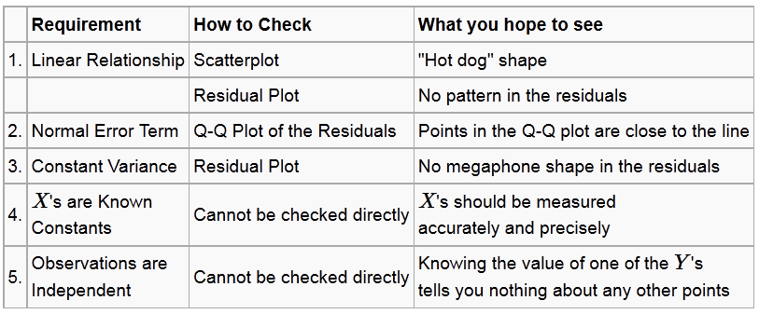
Requirements for Simple Linear Regression

Slide 6
Requirements for Simple Linear Regression

Slide 7
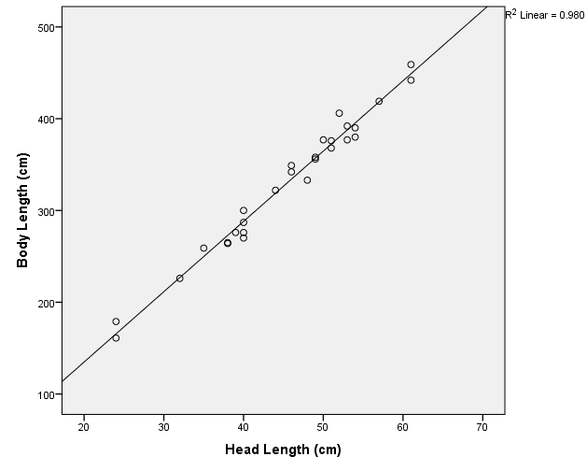
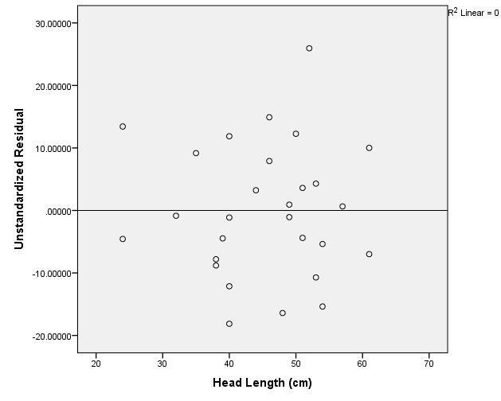
Checking Requirement for Linear Relationship
Crocodile Data – Predict Body Length based on Head Length
Scatterplot – Data has a “hot dog” shape
Residual plot – No Pattern
Residual = observed y – predicted y

Slide 8
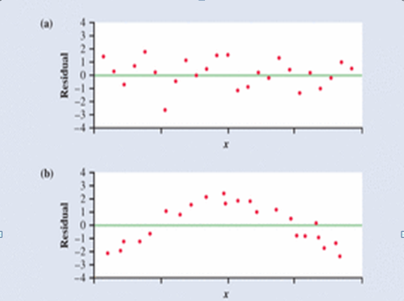
Checking Requirement for Linear Relationship
No Pattern
Pattern

Slide 9
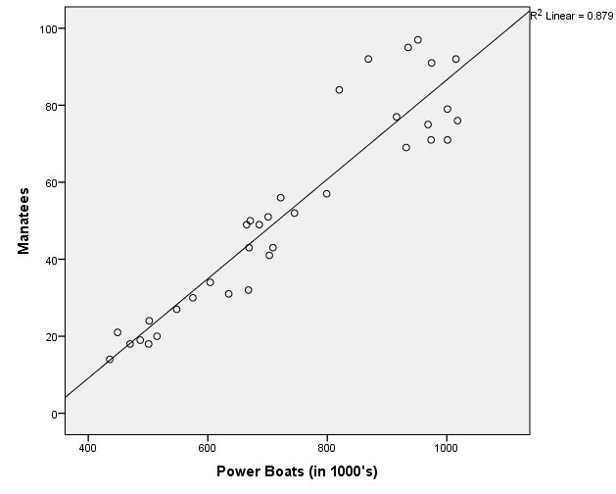
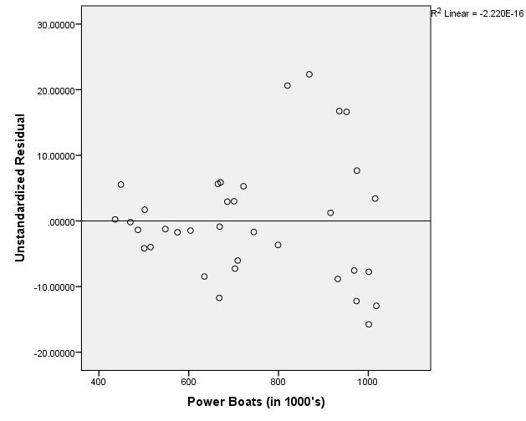
Checking Requirement for Linear Relationship
Manatee Data – Predict Manatees Killed based on # of Powerboats Registered
Scatterplot – Data has a “hot dog” shape
Residual plot – No Pattern

Slide 10
Checking Requirements for Normal Error Term

Slide 11
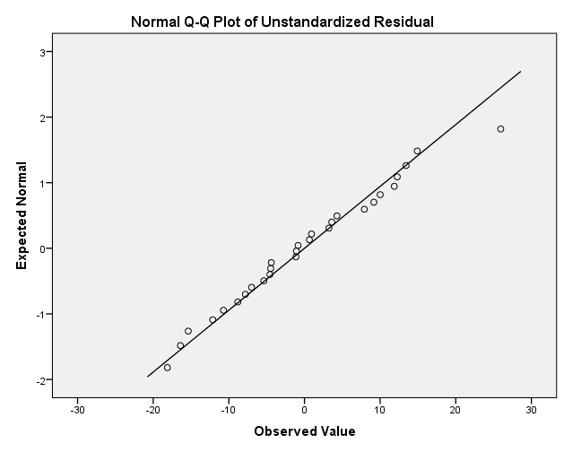
Checking Requirement for Normal Error Term
Crocodile Data– Predict Body Length based on Head Length
Points appear to be close to the line
Error term appears to be normal

Slide 12
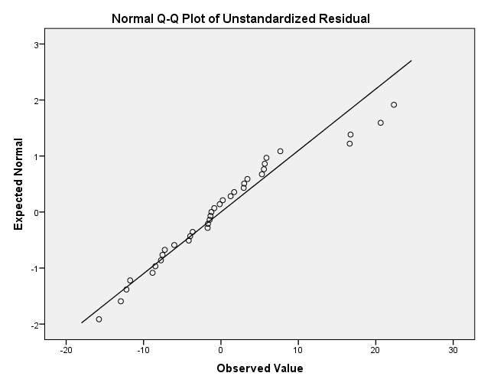
Checking Requirement for Normal Error Term
Manatee Data– Predict Manatees Killed based on # of Powerboats Registered
Points appear to be close to the line
Error term appears to be normal

Slide 13
Checking Requirements for Constant Variance

Slide 14
Checking Requirements for Constant Variance
Crocodile Data – Predict Body Length based on Head Length
Residual plot – No Megaphone Shape

Slide 15
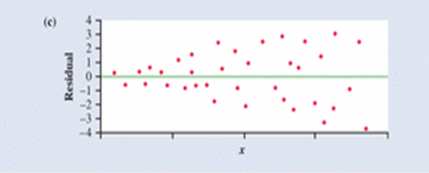
Checking Requirements for Constant Variance
Megaphone

Slide 16
Checking Requirements for Constant Variance
Manatee Data – Predict Manatees Killed based on # of Powerboats Registered
Residual plot – Slight Megaphone but not too bad

Slide 17
Inference for Bivariate Data
Intro to Inference in Regression
Requirements for Linear Regression
Linear Relationship
Constant Variances
Error term is normal
Hypothesis Testing
Confidence Interval

Slide 18
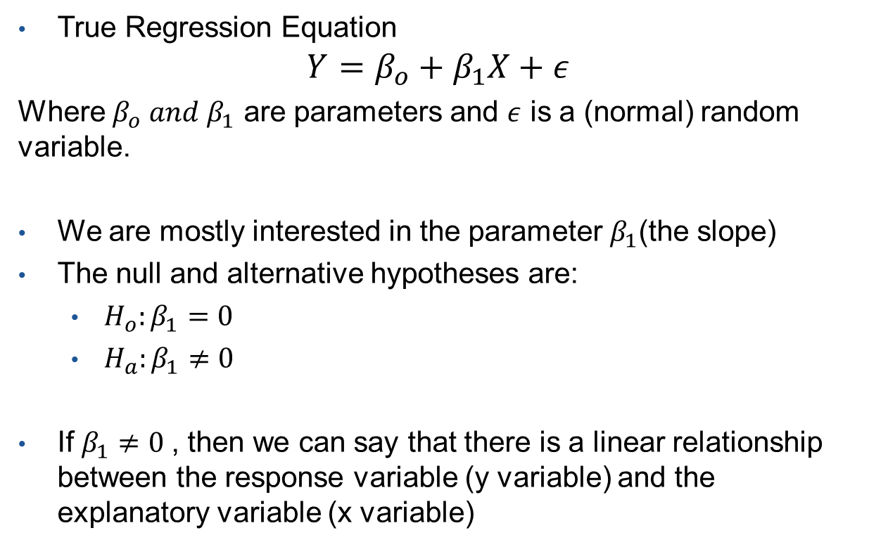
Hypothesis Testing
True Regression Equation
$$Y=β_{o}+β_{1}X+ε$$
Where $β_{o} and β_{1}$ are parameters and $ε$ is a (normal) random variable.
We are mostly interested in the parameter $β_{1}$(the slope)
The null and alternative hypotheses are:
  ${H_{o}:β}_{1}=0$
  ${H_{a}:β}_{1}≠0$
If $β_{1}≠0$, then we can say that there is a linear relationship between the response variable (y variable) and the explanatory variable (x variable)

Slide 19
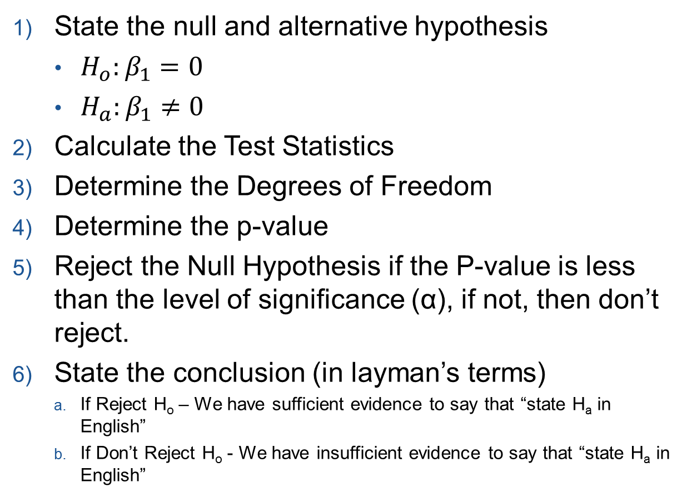
Hypothesis Testing
State the null and alternative hypothesis
  ${H_{o}:β}_{1}=0$
  ${H_{a}:β}_{1}≠0$
Calculate the Test Statistics
Determine the Degrees of Freedom
Determine the p-value
Reject the Null Hypothesis if the P-value is less than the level of significance (α), if not, then don’t reject.
State the conclusion (in layman’s terms)
  If Reject H_{o} – We have sufficient evidence to say that “state H_{a} in English”
  If Don’t Reject H_{o} - We have insufficient evidence to say that “state H_{a} in English”

Slide 20
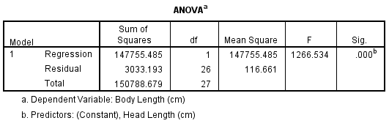
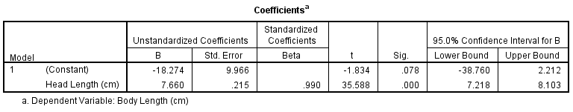
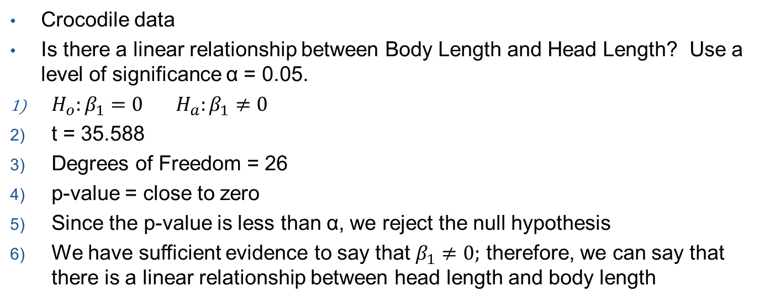
Hypothesis Testing
Crocodile data
Is there a linear relationship between Body Length and Head Length? Use a level of significance α = 0.05.
${H_{o}:β}_{1}=0 {H_{a}:β}_{1}≠0$
t = 35.588
Degrees of Freedom = 26
p-value = close to zero
Since the p-value is less than α, we reject the null hypothesis
We have sufficient evidence to say that $β_{1}≠0;$ therefore, we can say that there is a linear relationship between head length and body length

Slide 21
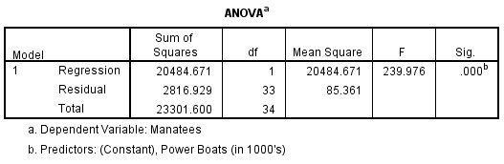
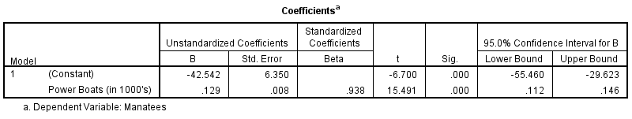
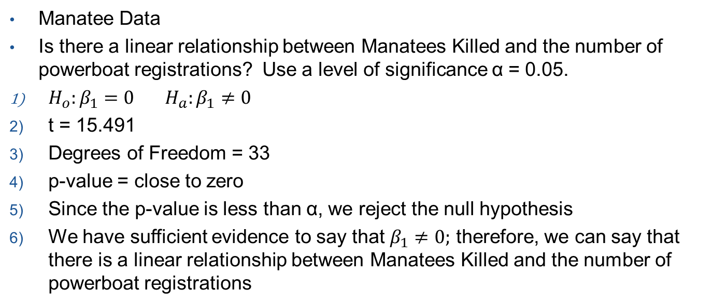
Hypothesis Testing
Manatee Data
Is there a linear relationship between Manatees Killed and the number of powerboat registrations? Use a level of significance α = 0.05.
${H_{o}:β}_{1}=0 {H_{a}:β}_{1}≠0$
t = 15.491
Degrees of Freedom = 33
p-value = close to zero
Since the p-value is less than α, we reject the null hypothesis
We have sufficient evidence to say that $β_{1}≠0;$ therefore, we can say that there is a linear relationship between Manatees Killed and the number of powerboat registrations

Slide 22
Inference for Bivariate Data
Intro to Inference in Regression
Requirements for Linear Regression
Linear Relationship
Constant Variances
Error term is normal
Hypothesis Testing
Confidence Interval

Slide 23
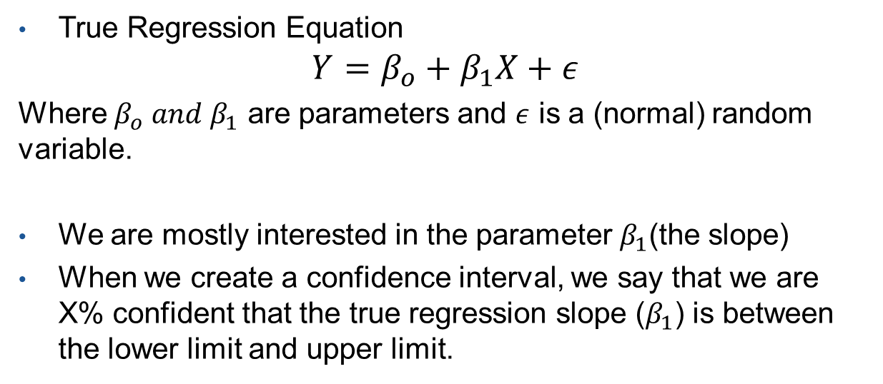
Confidence Interval
True Regression Equation
$$Y=β_{o}+β_{1}X+ε$$
Where $β_{o} and β_{1}$ are parameters and $ε$ is a (normal) random variable.
We are mostly interested in the parameter $β_{1}$(the slope)
When we create a confidence interval, we say that we are X% confident that the true regression slope ($β_{1}$) is between the lower limit and upper limit.

Slide 24
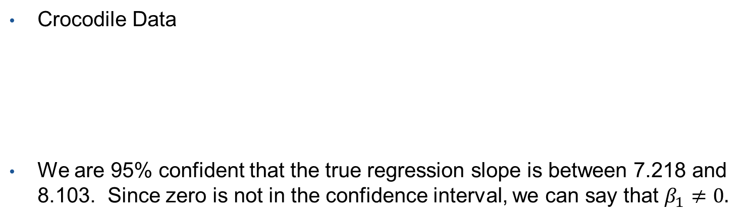

Confidence Interval
Crocodile Data
We are 95% confident that the true regression slope is between 7.218 and 8.103. Since zero is not in the confidence interval, we can say that $β_{1}≠0.$
Manatee Data
We are 95% confident that the true regression slope is between 0.112 and 0.146. Since zero is not in the confidence interval, we can say that $β_{1}≠0.$

